Slide 1
2: Hashing Hashing Types. Hashing Methods. Salting. Collisions. LM and NTLM Hashes (Windows). Hash Benchmarks. Message Authentication Codes (MACs). OTP/HOTP. Prof Bill Buchanan OBE http://asecuritysite.com/encryption

Slide 2
2: Hashing Hashing Types. Hashing Methods. Salting. Collisions. LM and NTLM Hashes (Windows). Hash Benchmarks. Message Authentication Codes (MACs). OTP/HOTP. Prof Bill Buchanan OBE http://asecuritysite.com/encryption

Slide 3
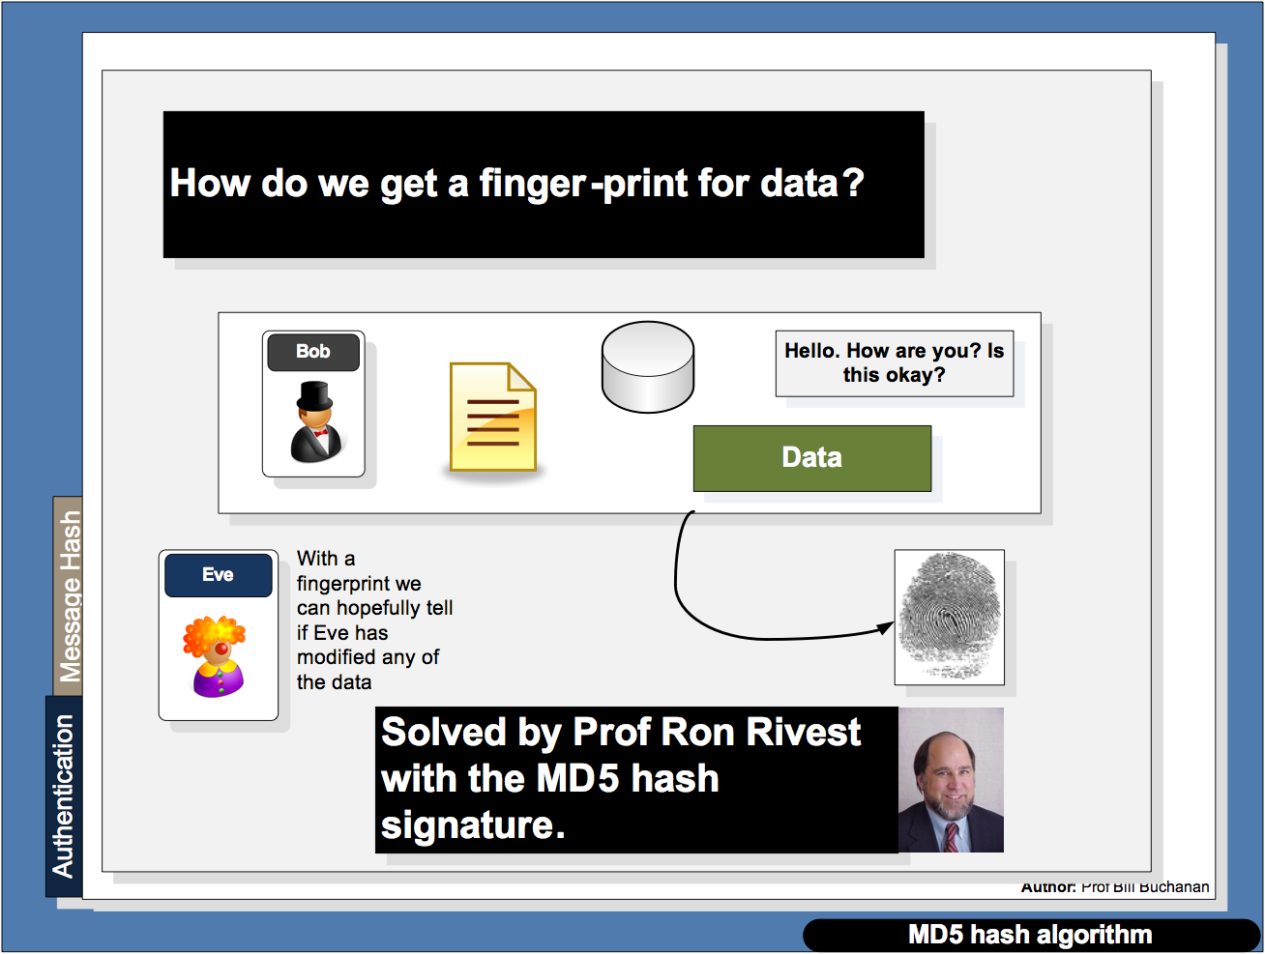

Slide 4
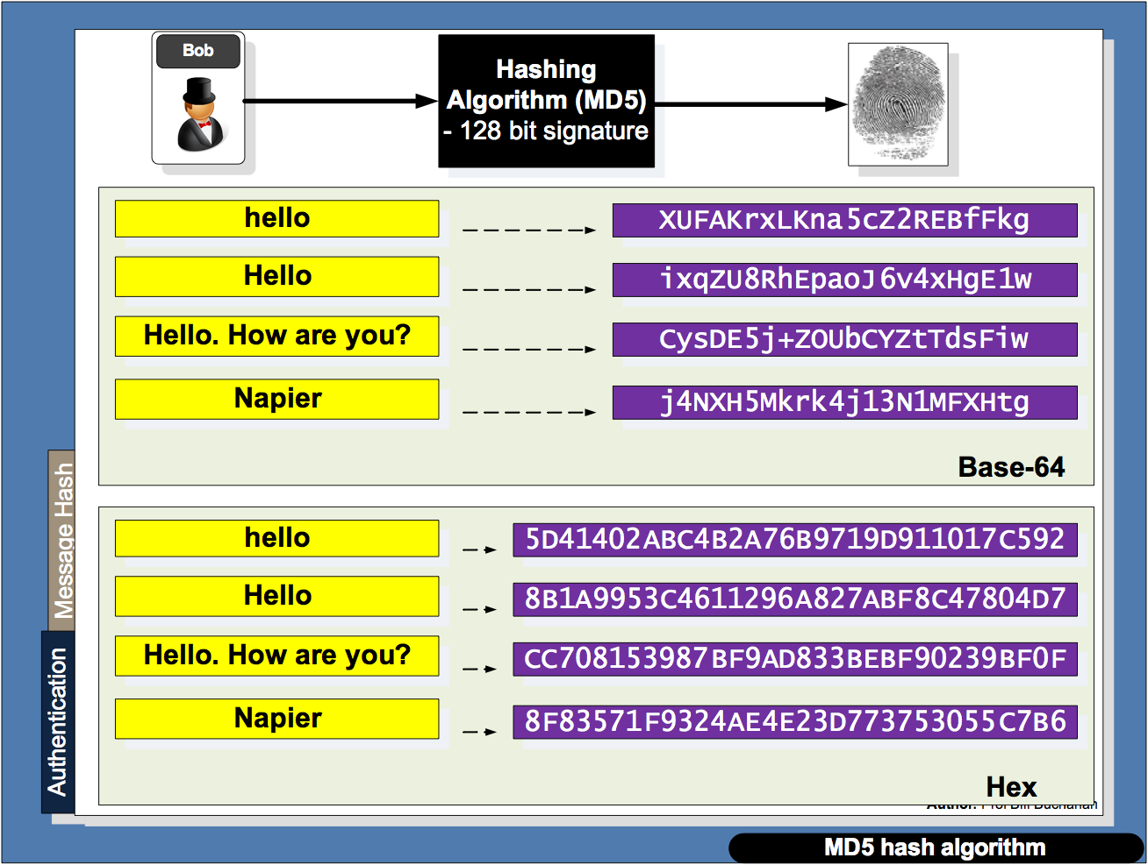

Slide 5
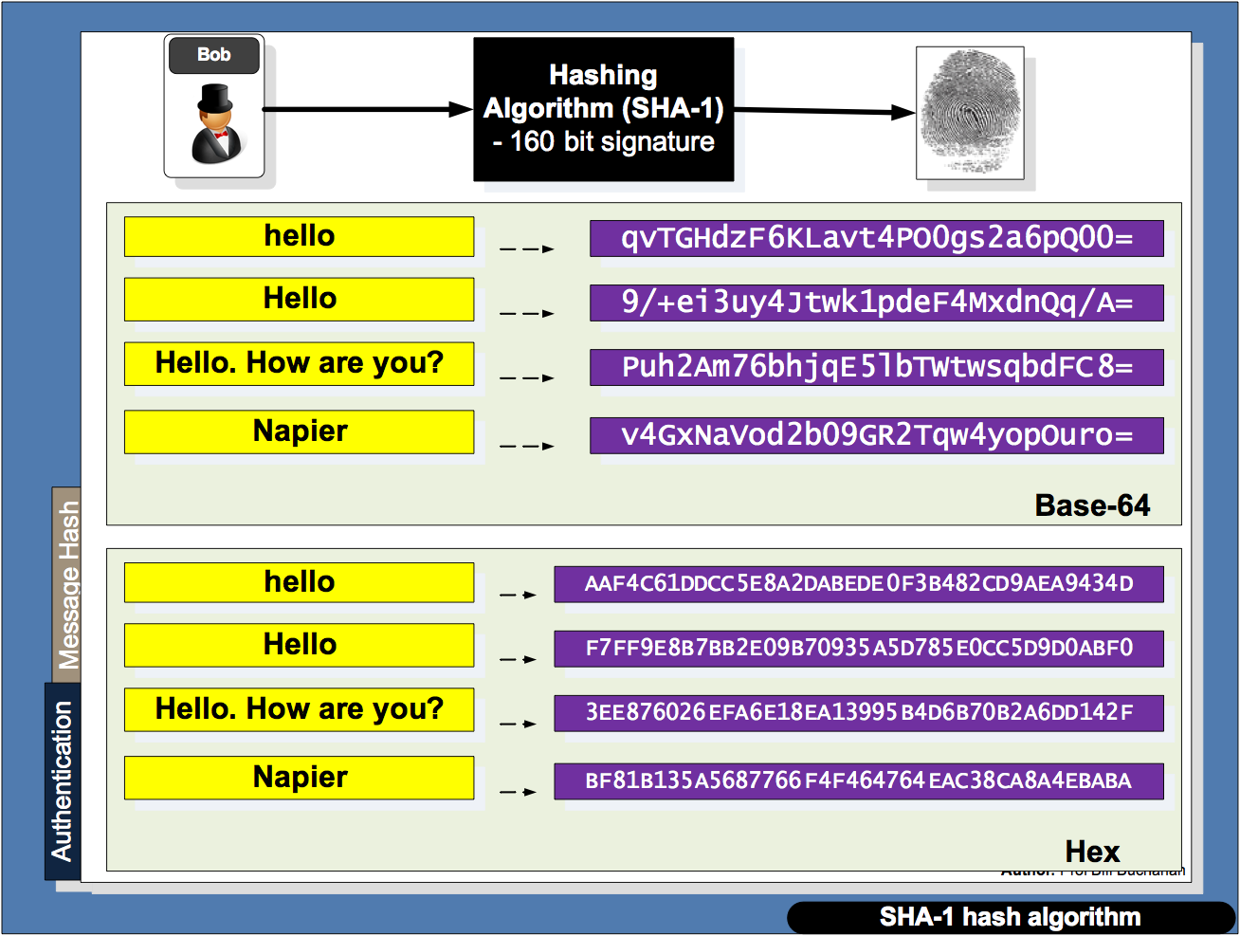

Slide 6
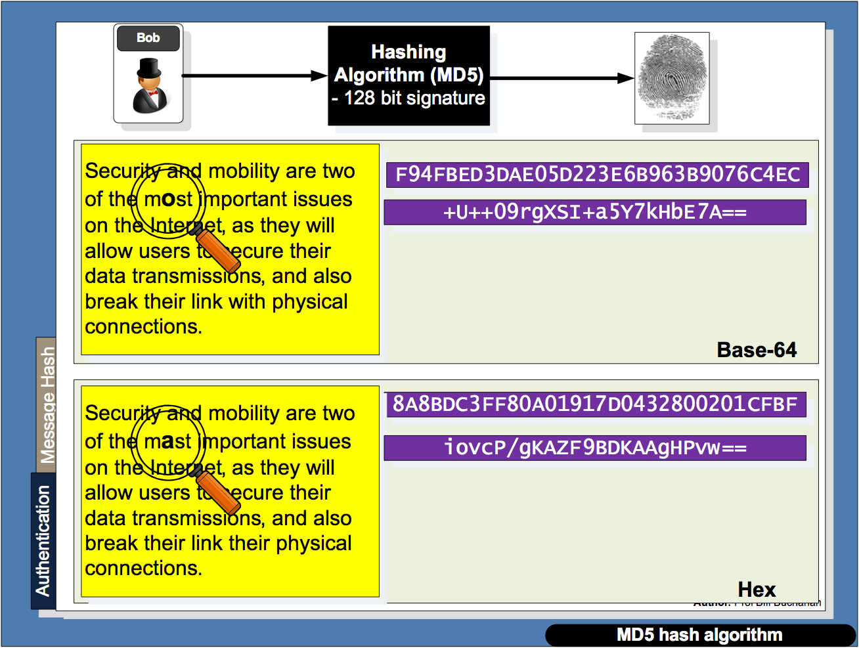

Slide 7
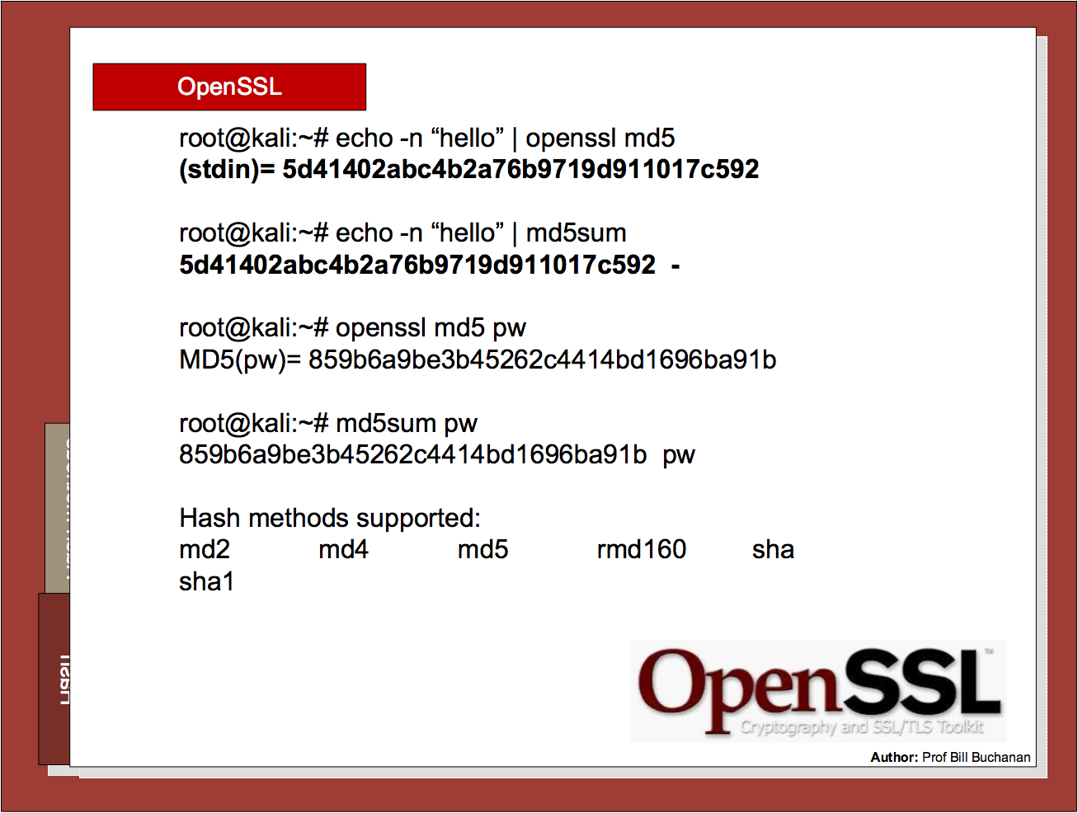

Slide 8
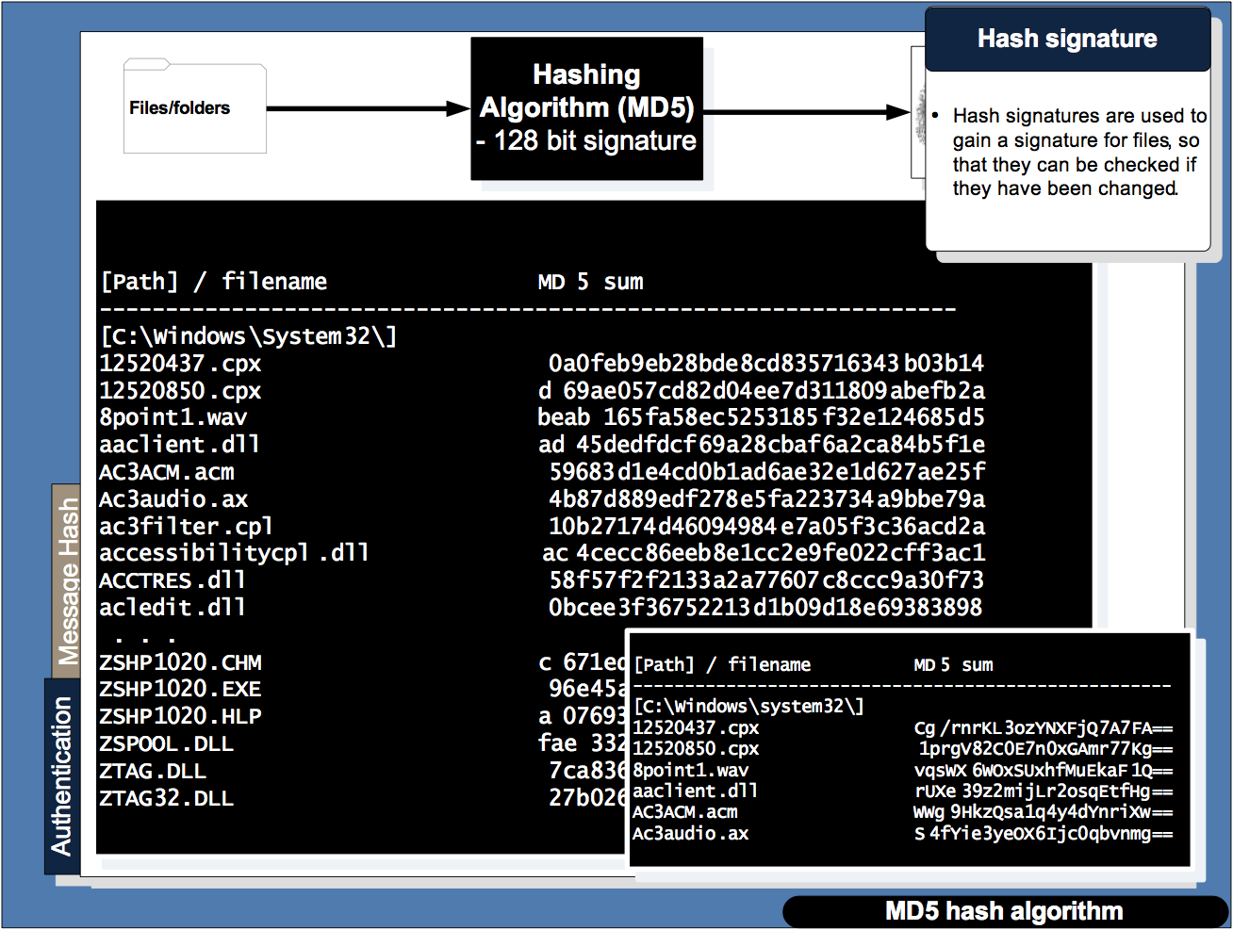

Slide 9
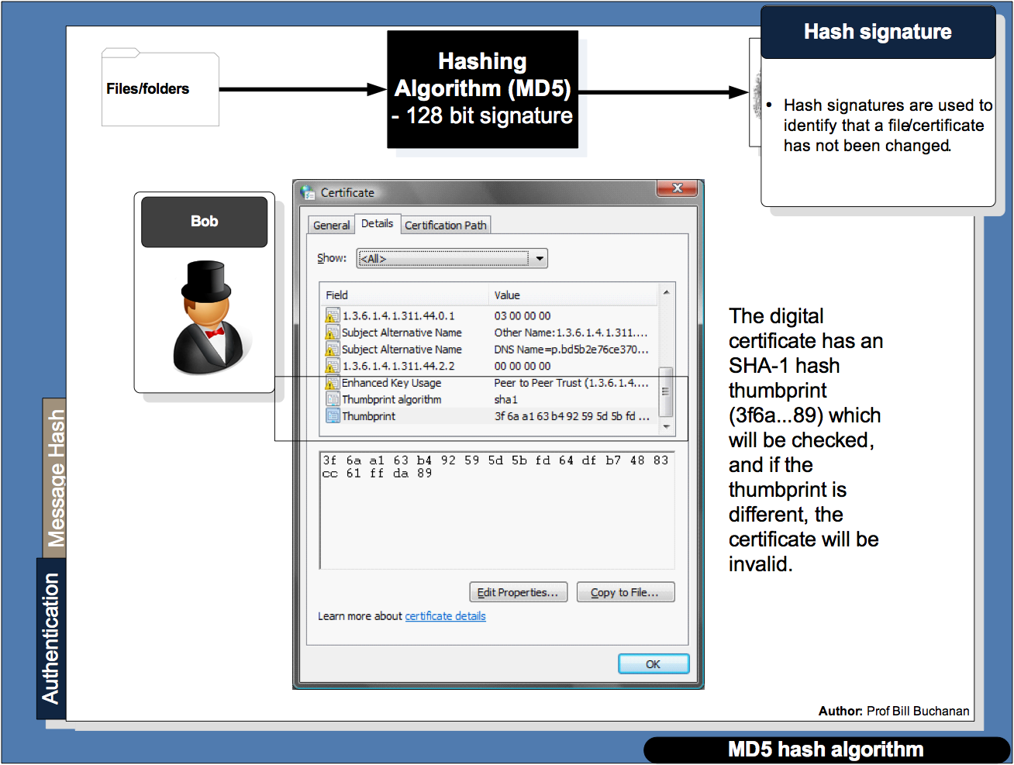

Slide 10
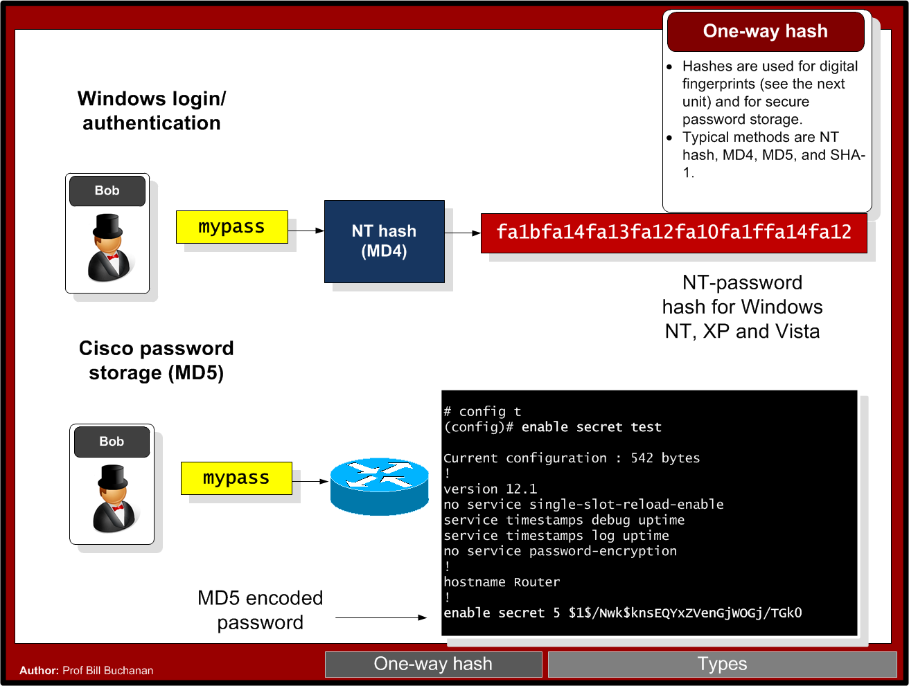

Slide 11
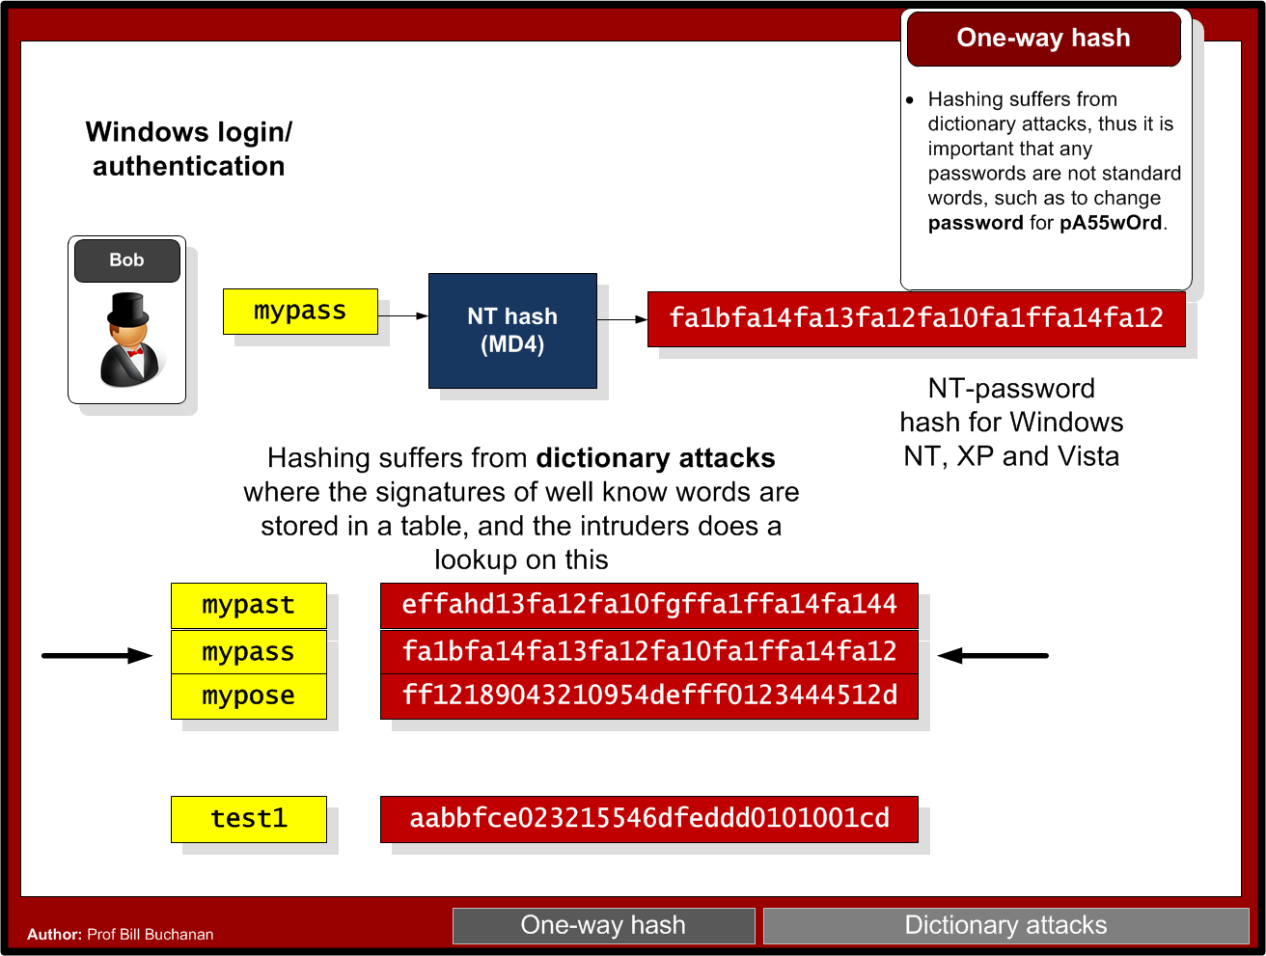

Slide 12
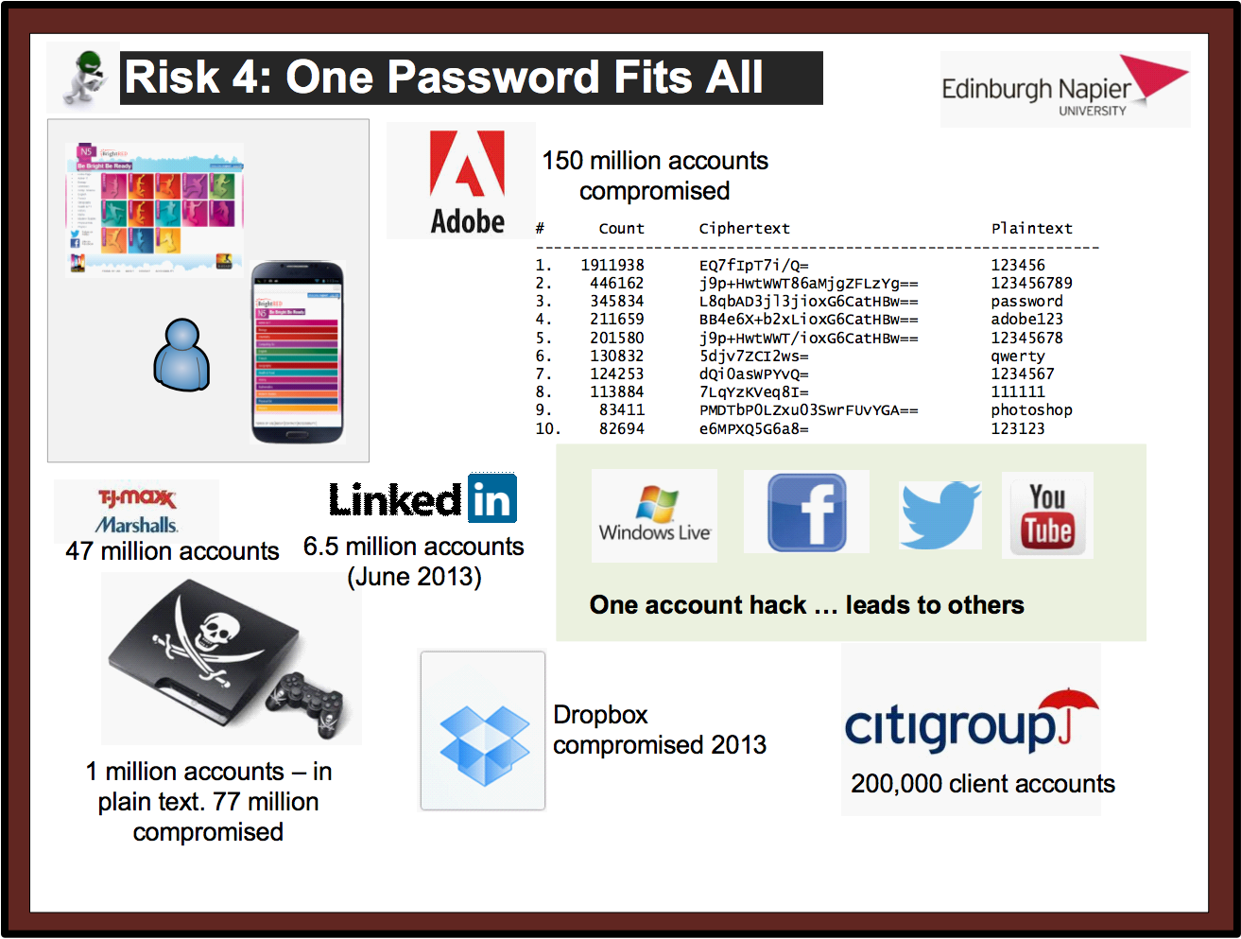

Slide 13
2: Hashing Hashing Types. Hashing Methods. Salting. Collisions. LM and NTLM Hashes (Windows). Hash Benchmarks. Message Authentication Codes (MACs). OTP/HOTP. Prof Bill Buchanan OBE http://asecuritysite.com/encryption

Slide 14
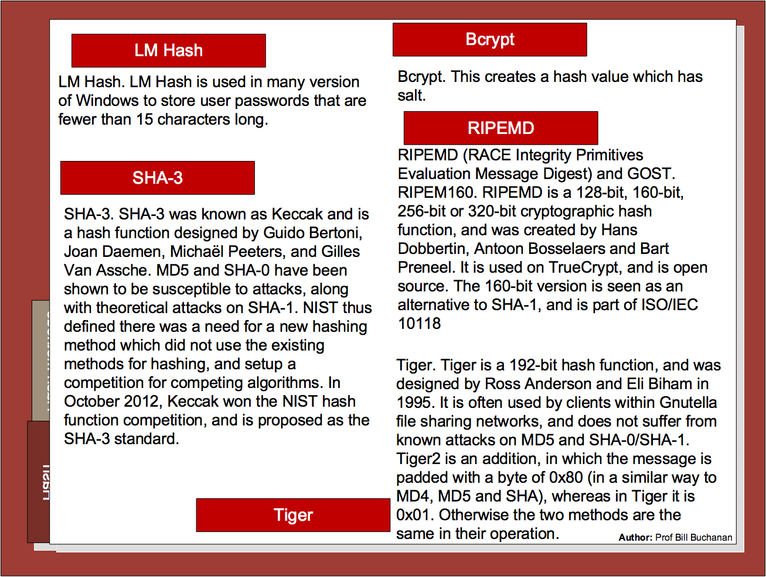

Slide 15
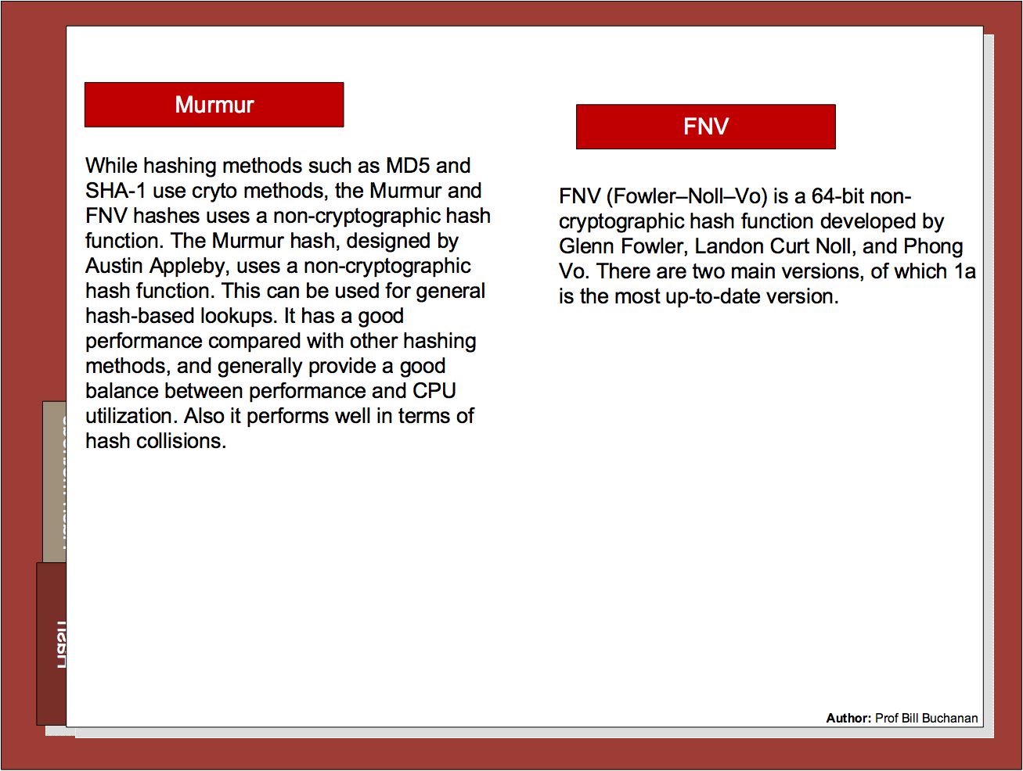

Slide 16
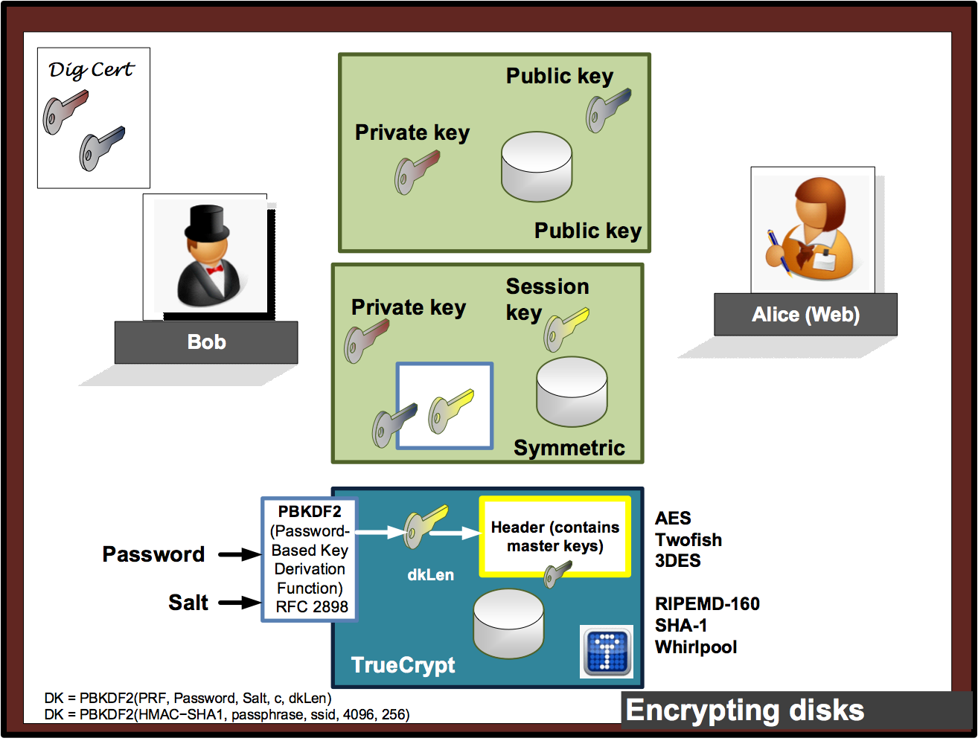

Slide 17

2: Hashing Hashing Types. Hashing Methods. Salting. Collisions. LM and NTLM Hashes (Windows). Hash Benchmarks. Message Authentication Codes (MACs). OTP/HOTP. Prof Bill Buchanan OBE http://asecuritysite.com/encryption

Slide 18
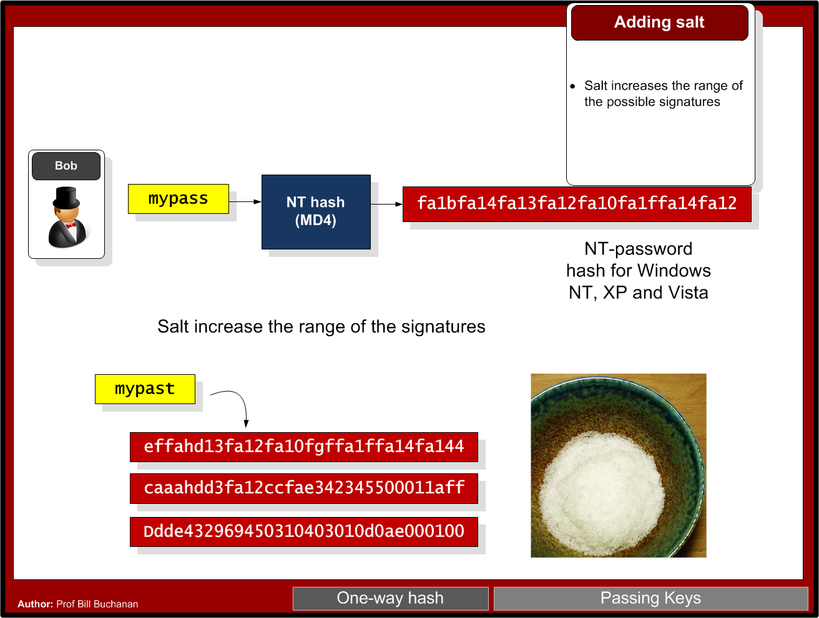

Slide 19
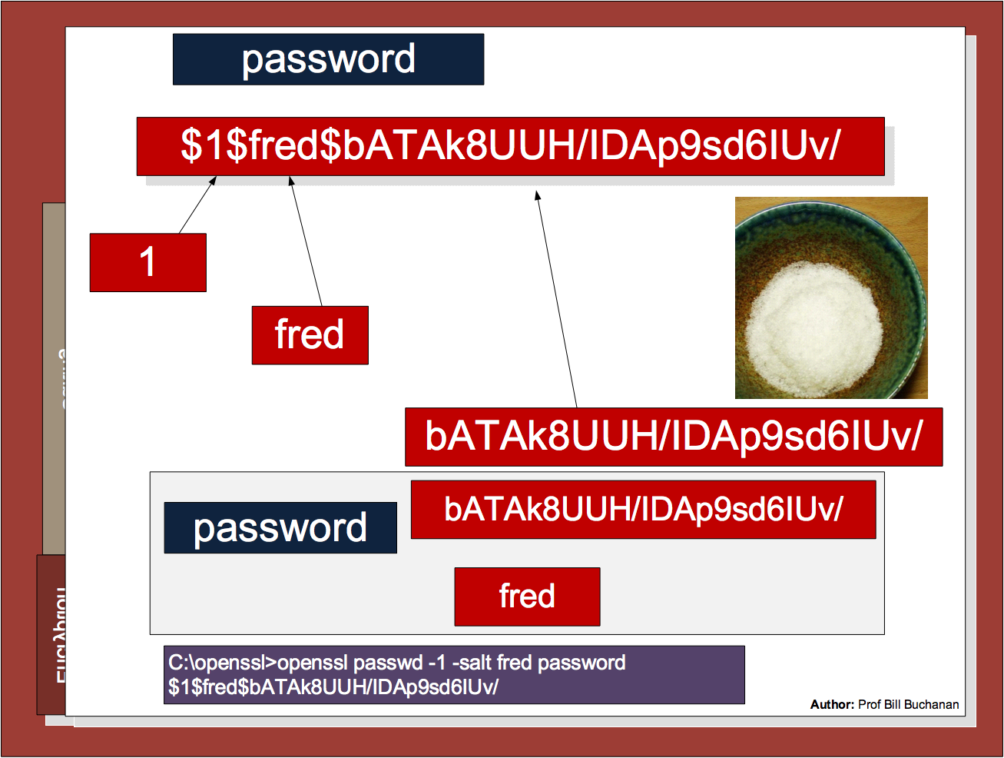

Slide 20
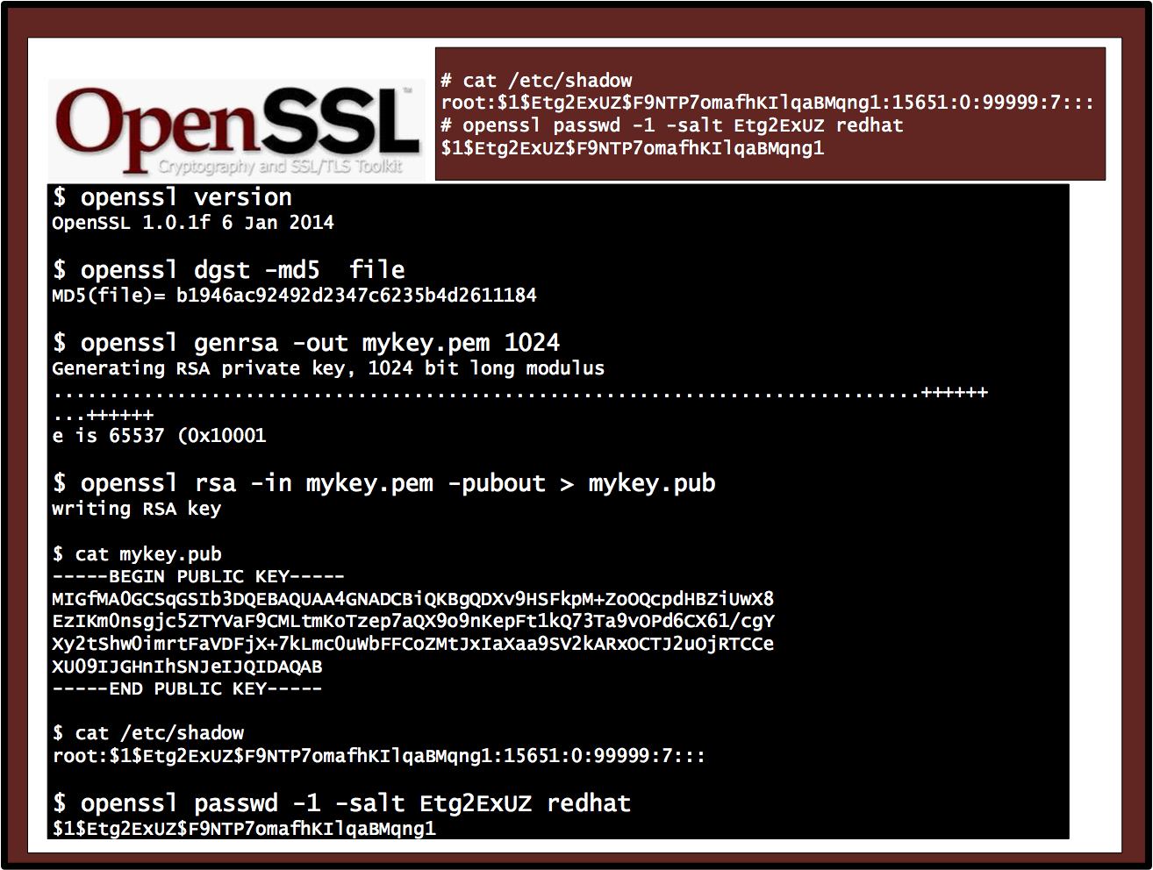

Slide 21
2: Hashing Hashing Types. Hashing Methods. Salting. Collisions. LM and NTLM Hashes (Windows). Hash Benchmarks. Message Authentication Codes (MACs). OTP/HOTP. Prof Bill Buchanan OBE http://asecuritysite.com/crypto03 http://asecuritysite.com/encryption

Slide 22
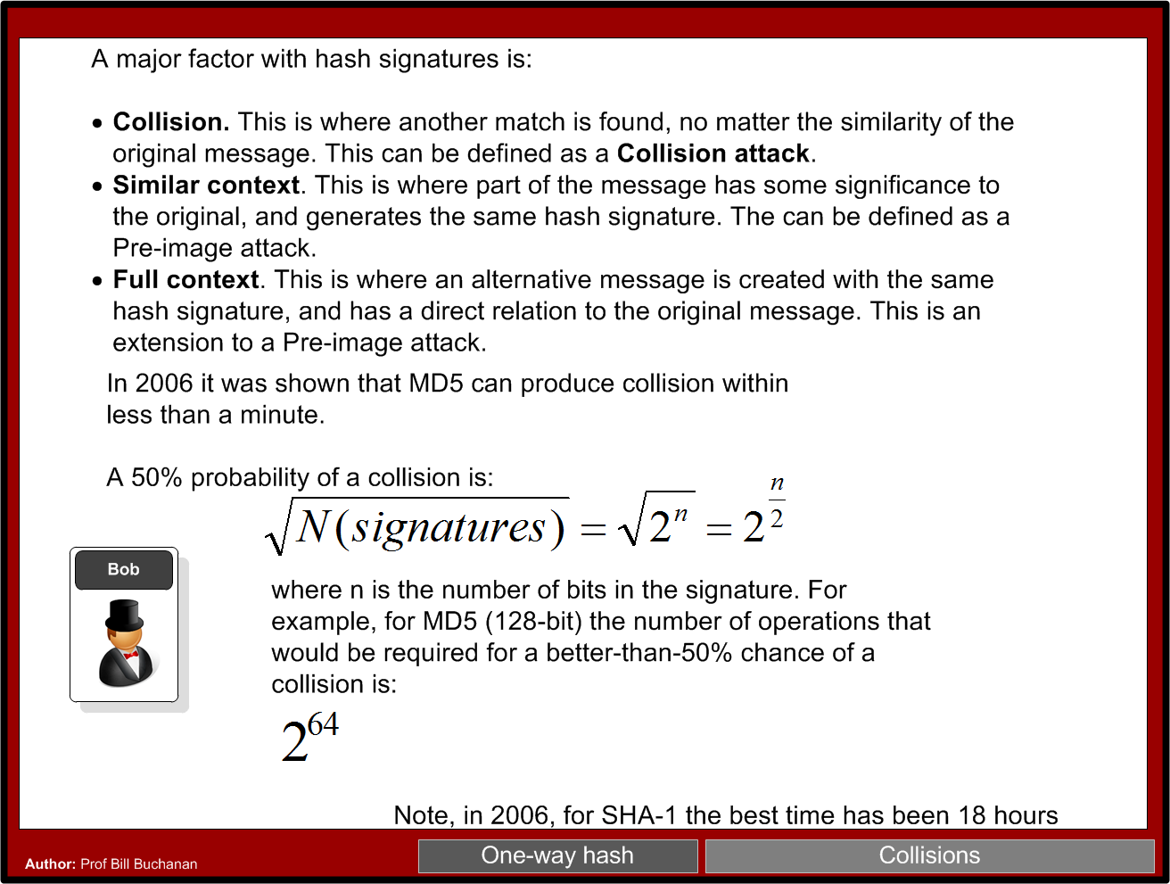

Slide 23
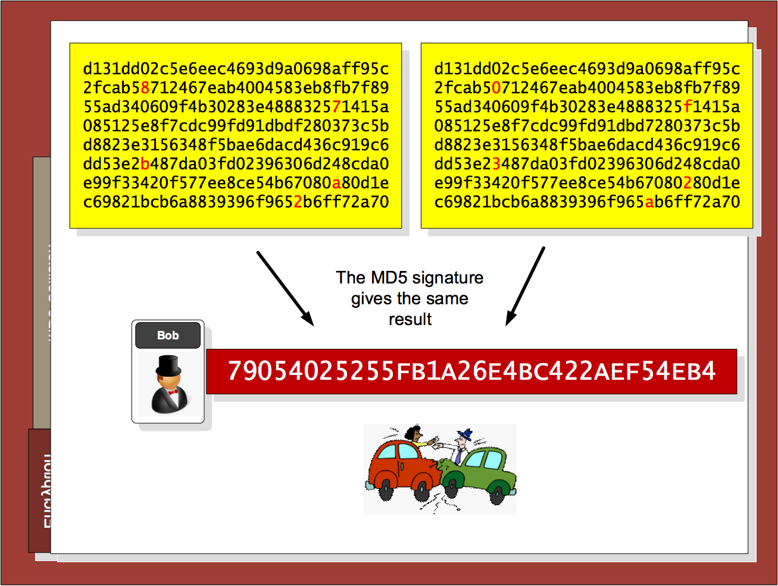

Slide 24
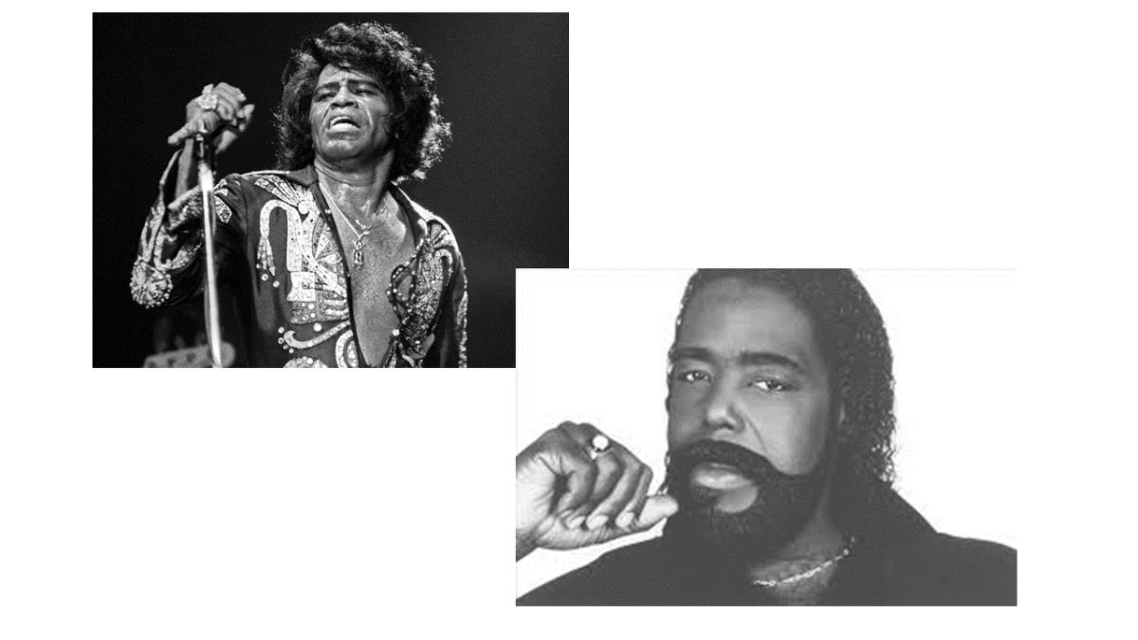
Nat McHugh
10 hours of computing on the Amazon GPU Cloud.
Cost: 60 cents
Used: Hashcat (on CUDA)
Birthday attack: A group size of only 70 people results in a 99.9% chance of two people sharing the same birthday.
M-bit output there are 2^m messages, and the same hash value would only require 2^(m/2) random messages. 18,446,744,073,709,551,616.
C:\openssl>openssl md5 hash01.jpg MD5(hash01.jpg)= e06723d4961a0a3f950e7786f3766338 C:\openssl>openssl md5 hash02.jpg MD5(hash02.jpg)= e06723d4961a0a3f950e7786f3766338

Slide 25
2: Hashing Hashing Types. Hashing Methods. Salting. Collisions. LM and NTLM Hashes (Windows). Hash Benchmarks. Message Authentication Codes (MACs). OTP/HOTP. Prof Bill Buchanan OBE http://asecuritysite.com/encryption

Slide 26
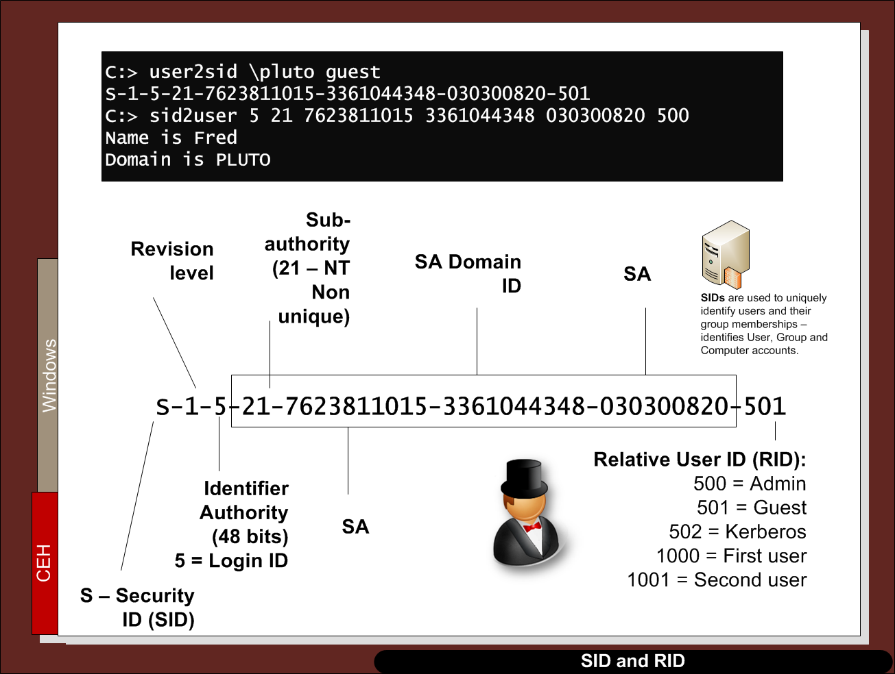

Slide 27
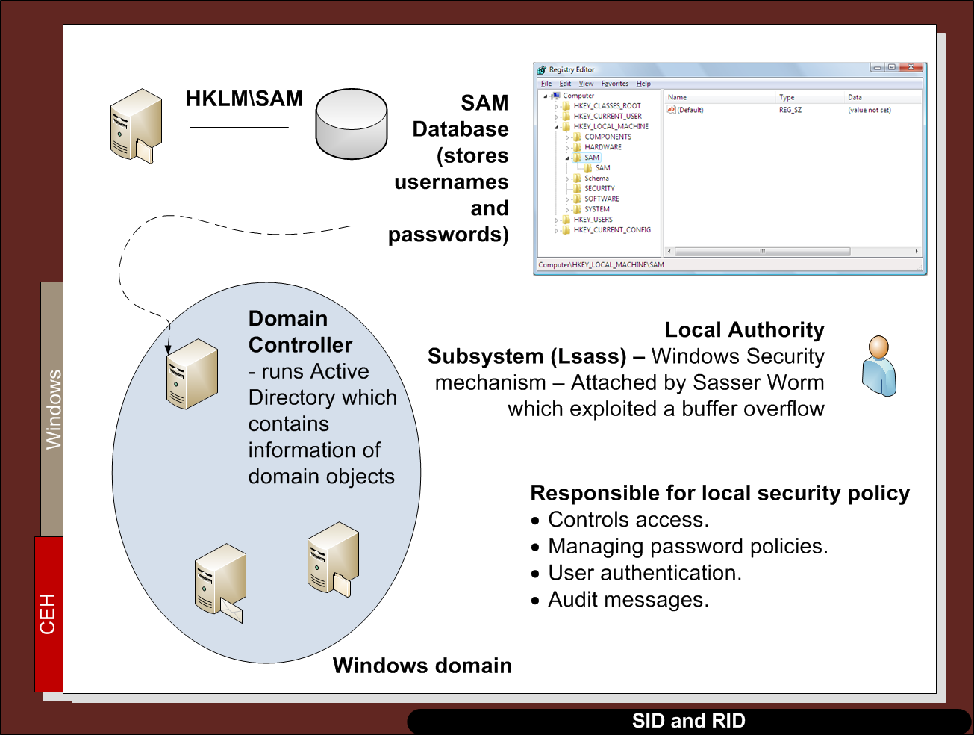

Slide 28
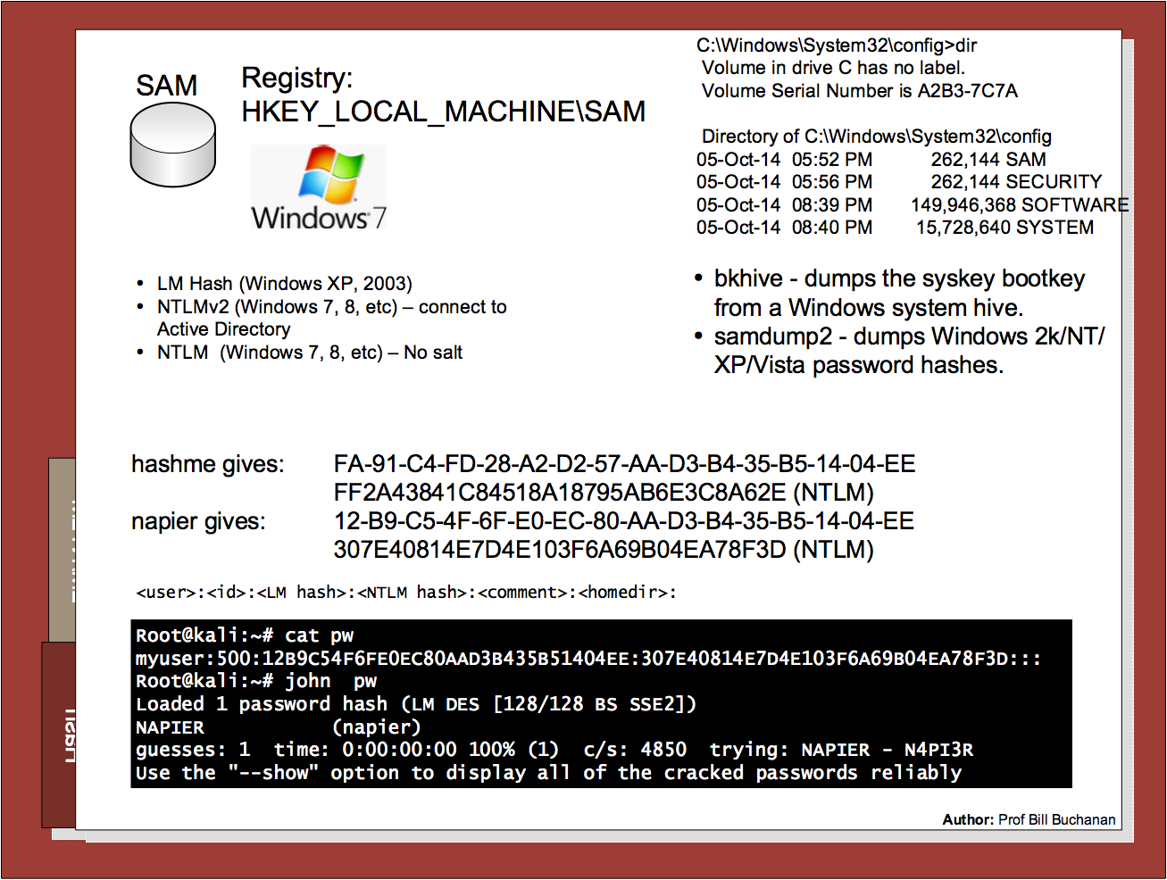

Slide 29
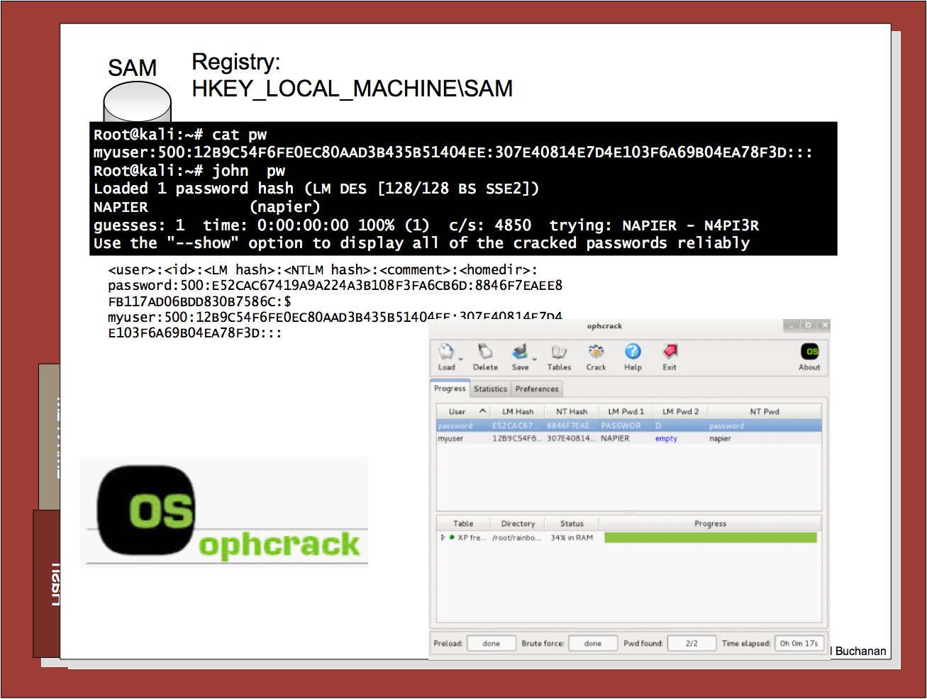

Slide 30
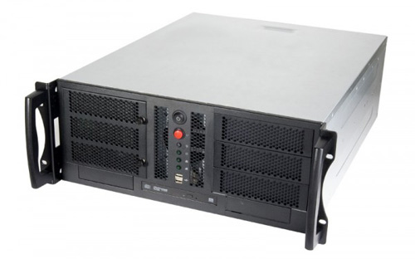
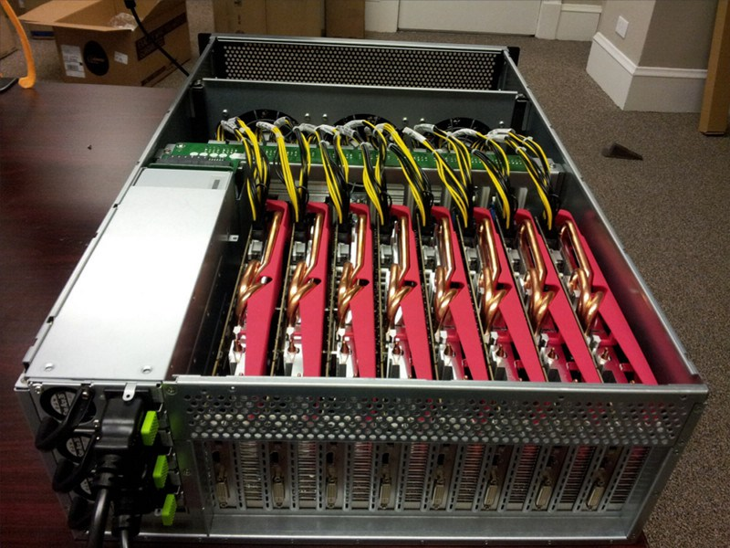
Hash Crackers/Bit Coin Miners
Fast Hash One
1.536TH/s – Cost 3-5,000 dollars.
25 GPU Hash Cracker
An eight character NTLM password cracked in 5.5 hours. 14 character LM hash cracked in six minutes. 350 billion hashes per second.

Slide 31
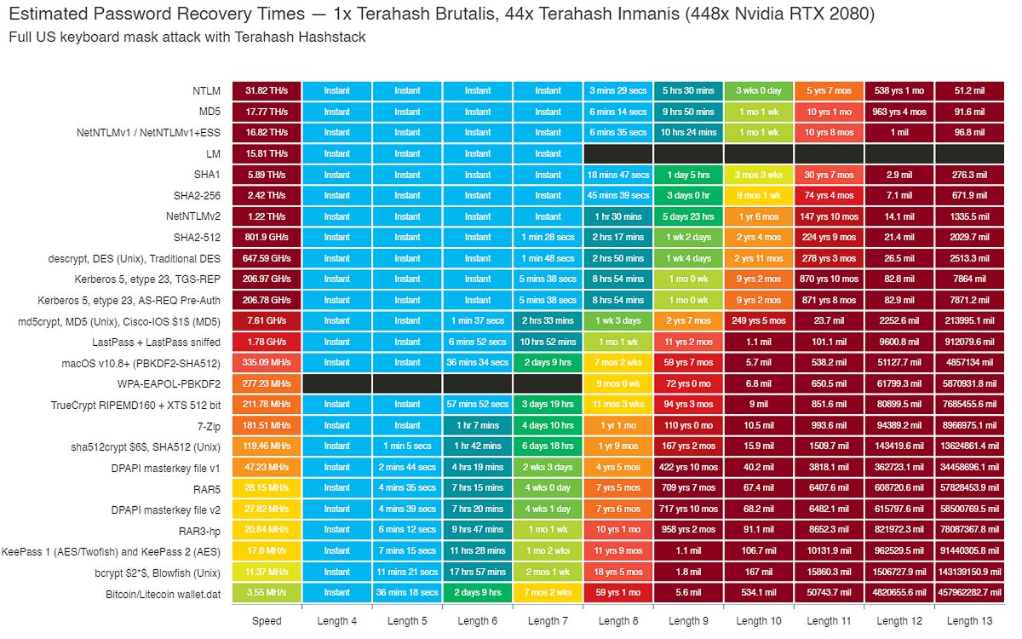
Hash Crackers/Bit Coin Miners
Fast Hash One
1.536TH/s – Cost 3-5,000 dollars.
25 GPU Hash Cracker
An eight character NTLM password cracked in 5.5 hours. 14 character LM hash cracked in six minutes. 350 billion hashes per second.

Slide 32
2: Hashing Hashing Types. Hashing Methods. Salting. Collisions. LM and NTLM Hashes (Windows). Hash Benchmarks. Message Authentication Codes (MACs). OTP/HOTP. Prof Bill Buchanan OBE http://asecuritysite.com/crypto03 http://asecuritysite.com/encryption

Slide 33
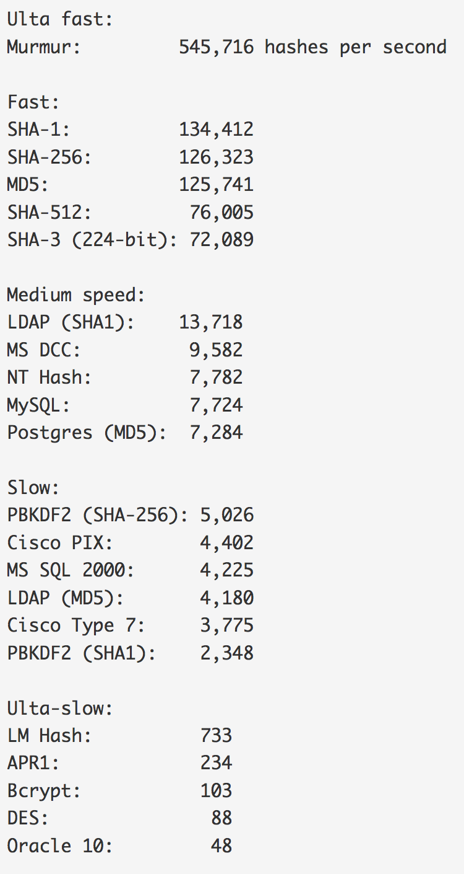
Benchmark
Hashes “The quick brown fox jumps over the lazy dog:
SHA-1: 2fd4e1c67a2d28fced849ee1bb76e7391b93eb12
SHA-256: d7a8fbb307d7809469ca9abcb0082e4f8d5651e46d3cdb762d02d0bf37c9e592
SHA-512: 07e547d9586f6a73f73fbac0435ed76951218fb7d0c8d788a309d7
85436bbb642e93a252a954f23912547d1e8a3b5ed6e1bfd7097821233fa0538f3db854fee6
MD-5: 9e107d9d372bb6826bd81d3542a419d6
DES: ZDeS94Lcq/6zg
Bcrypt: $2a$05$2czCv5GYgkx3aobmEyewB.ejV2hePMdbvTdCyNaSzWtlGPPjB2xx6
APR1: $apr1$ZDzPE45C$3PvRanPycmNc6c2G9wT9b/
PBKDF2 (SHA1): $pbkdf2$5$WkR6UEU0NUM$0RB2bimWrMY.EPYibpaBT2q3HFg
PBKDF2 (SHA-256): $pbkdf2-sha256$5$WkR6UEU0NUM$yrJz2oJix7uBJZwZ/50vWUgdE
I/i0ffqeU4obqC0pk4
LM Hash: a7b07f9948d8cc7f97c4b0b30cae500f
NT Hash: 4e6a076ae1b04a815fa6332f69e2e231
MS DCC: efa9778bbc94a7360f664eb7d7144725
LDAP (MD5): {MD5}9e107d9d372bb6826bd81d3542a419d6
LDAP (SHA1): {SHA}2fd4e1c67a2d28fced849ee1bb76e7391b93eb12
MS SQL 2000: 0x0100BF77CE595DCD1FC87A37B3DEBC27A8C97355CB96B8BAB
63E602662BA5D5D33B913E422499BE72FF3D9BB65DE
MySQL: *A4E4D26FD0C6455E23E2187C3AABE844332AA1B3
Oracle 10: 4CDA2299FCAD0499
Postgres (MD5): md5d44c15daa11770f25c5350f7e5408dd1
Cisco PIX: kGyKN5CqdFQ1qJUs
Cisco Type 7: 15260309443B3E2D2B3875200108010D41505640135E1B0E080
519574156401540035E460B594D1D53020B5C
Benchmark

Slide 34
Slowing a hash
To slow the hash, we can use rounds, where we continually hash for a number of rounds. In the following we use 5,000 rounds:
===Splunk hashed password===
User: Fred
Password: qwerty123
Salt: Uk8SVGLsBuSmD75R
===Hashed password Fred:$6$Uk8SVGLsBuSmD75R$Lhp5yjwRUAM.LbH5IIthZ1u0bAUdJwBvvccBshAvpFPiRn62EYeiKOaP8xh97aV4UaNfVykRZhUy/3ZOZd1oc.
root@kali:~# hashcat -b -m 1800
Initializing hashcat v0.49 with 1 threads and 32mb segment-size…
Device………..: Intel(R) Core(TM) i7–8850H CPU 2.60GHz
Instruction set..: x86_64
Number of threads: 1
Hash type: sha512crypt, SHA512(Unix)
Speed/sec: 454 words
root@kali:~# hashcat -b -m 0
Initializing hashcat v0.49 with 1 threads and 32mb segment-size…
Device: Intel(R) Core(TM) i7–8850H CPU 2.60GHz
Instruction set..: x86_64
Number of threads: 1
Hash type: MD5
Speed/sec: 17.33M words
SHA512-crypt

Slide 35
2: Hashing Hashing Types. Hashing Methods. Salting. Collisions. LM and NTLM Hashes (Windows). Hash Benchmarks. Message Authentication Codes (MACs). OTP/HOTP. Prof Bill Buchanan OBE http://asecuritysite.com/crypto02 http://asecuritysite.com/encryption

Slide 36
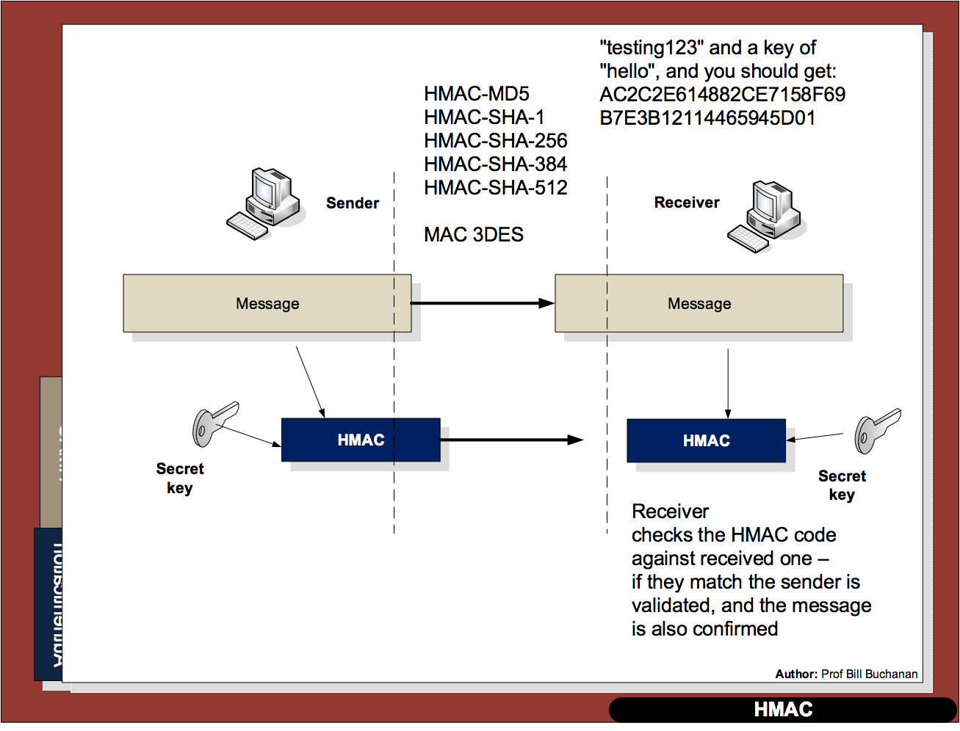

Slide 37
2: Hashing Hashing Types. Hashing Methods. Salting. Collisions. LM and NTLM Hashes (Windows). Hash Benchmarks. Message Authentication Codes (MACs). OTP/HOTP. Prof Bill Buchanan OBE http://asecuritysite.com/crypto03 http://asecuritysite.com/encryption

Slide 38
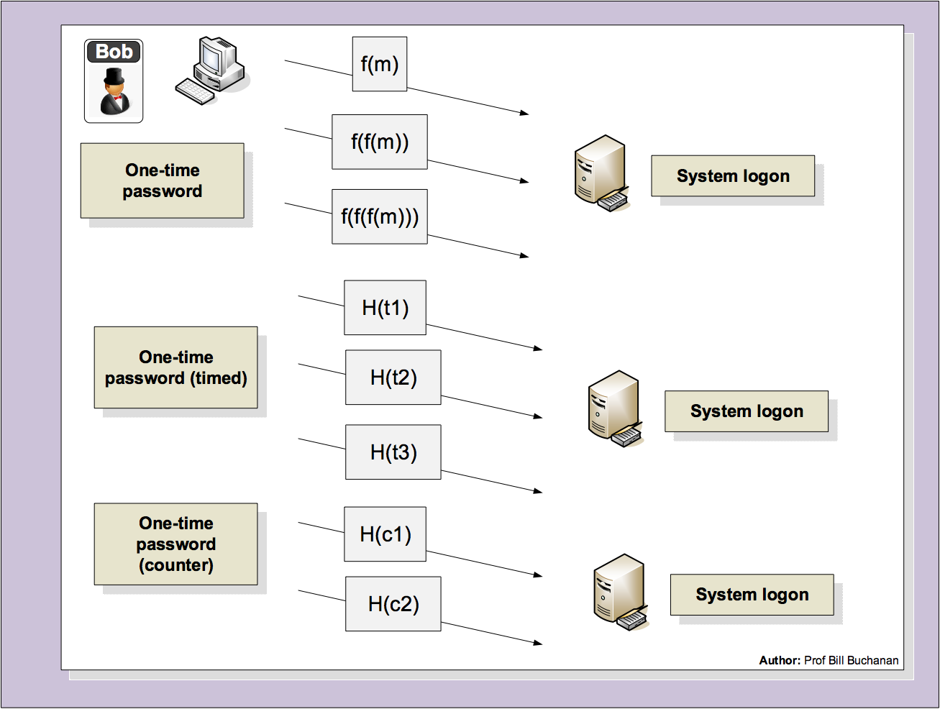

Slide 39
2: Hashing Hashing Types. Hashing Methods. Salting. Collisions. LM and NTLM Hashes (Windows). Hash Benchmarks. Message Authentication Codes (MACs). OTP/HOTP. Prof Bill Buchanan OBE http://asecuritysite.com/crypto03 http://asecuritysite.com/encryption

Slide 40
Hashcat
Rule-based Attacks. Define a rule of the password.
Dictionary Attacks. Search through a dictionary of common passwords.
Brute-Force Attacks. Search through
Attack modes: Brute-force, Combinator, Dictionary, Mask, Rule-based, Toggle-case and Hybrid.

